Slide 1
Dimensionality reduction
Lecture 2c

Slide 2


Latent variables
Sometimes data depends on the variables we can not measure (or hard to measure)
Answers on the test depend on Intelligence
Brain activity in the brain is measured by sensors
Stock prices depend on market confidence
X
Z
Source: Leadliaison.com
$$X=g(Z)$$

Slide 3
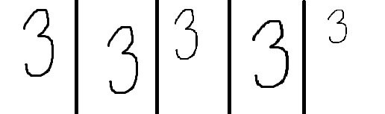
Latent variables
Latent factor discovered→ data storage may decrease a lot
Latent factors
Center
Scaling
Original vs compressed
100x100x5=50000
100x100+2*5+2*5=10020

Slide 4
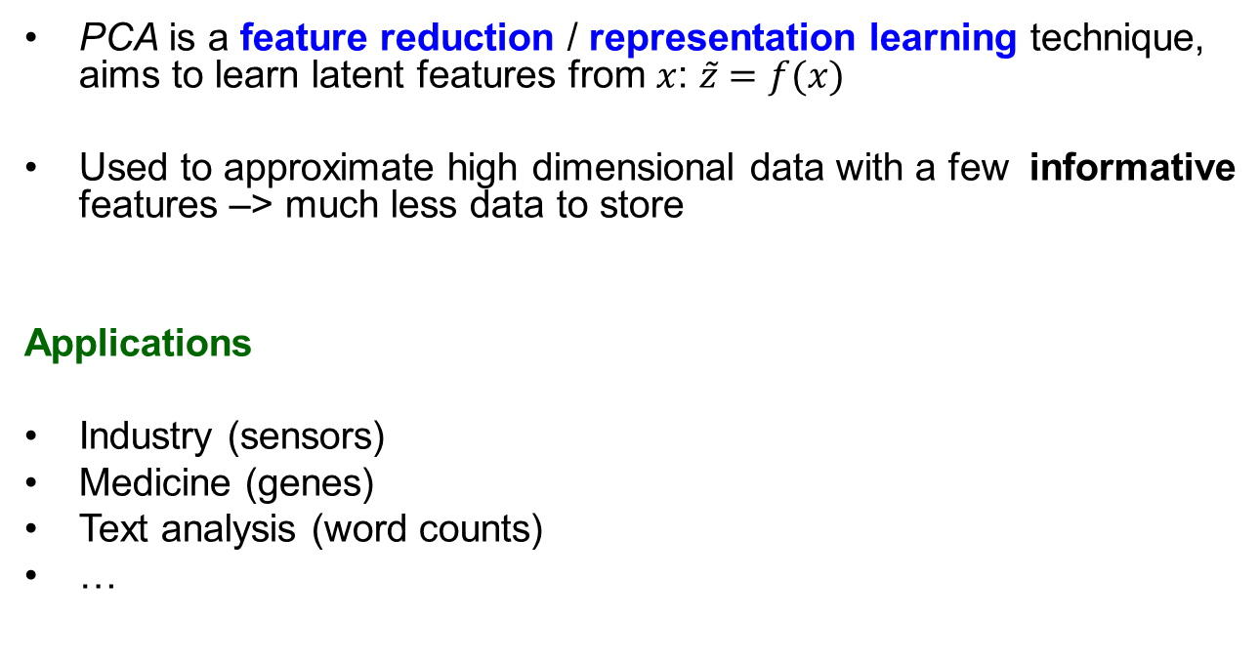
Principal Component Analysis (PCA)
PCA is a feature reduction / representation learning technique, aims to learn latent features from $x$: $\tilde{z}=f(x)$
Used to approximate high dimensional data with a few informative features –> much less data to store
Applications
Industry (sensors)
Medicine (genes)
Text analysis (word counts)
…

Slide 5
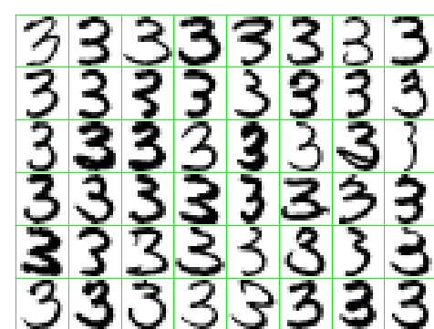
Principal Component Analysis (PCA)
Example 1: Hadwritten digits
Can we get a more compact summary?

Slide 6
Principal components analysis
Idea: Introduce a new coordinate system (PC1, PC2, …) where
The first principal component (PC1) is the direction that maximizes the variance of the projected data
The second principal component (PC2) is the direction that maximizes the variance of the projected data after the variation along PC1 has been removed
The third principal component (PC3) is the direction that maximizes the variance of the projected data after the variation along PC1 and PC2 has been removed
….
In the new coordinate system, coordinates corresponding to the last principal components are very small → can take away these columns

Slide 7
Principal Component Analysis - two inputs
PC1
PC2

Slide 8
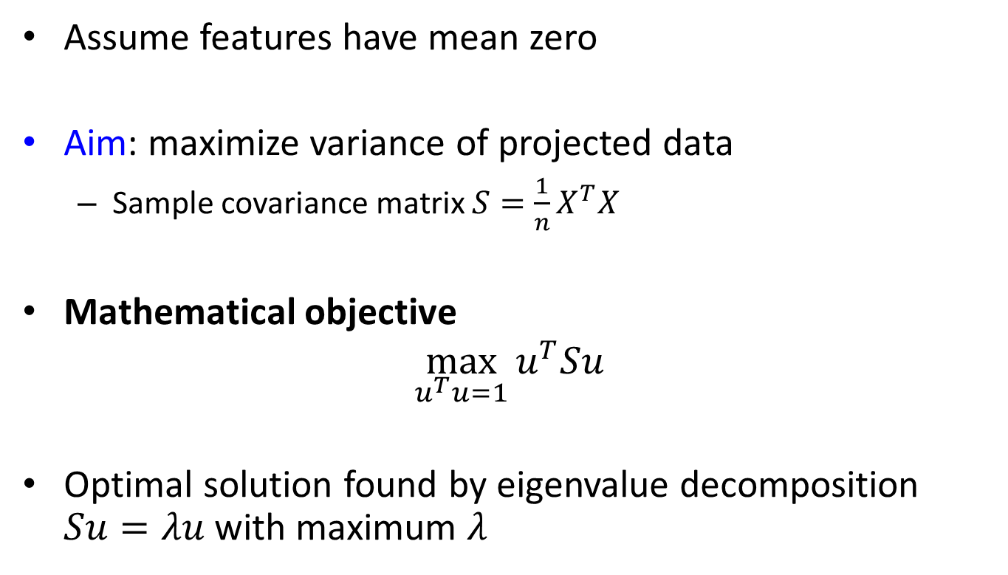
Principal component analysis
Assume features have mean zero
Aim: maximize variance of projected data
Sample covariance matrix $S=\frac{1}{n}X^{T}X$
Mathematical objective
$$\max_{u^{T}u=1}{u^{T}Su}$$
Optimal solution found by eigenvalue decomposition $Su=λu$ with maximum $λ$

Slide 9
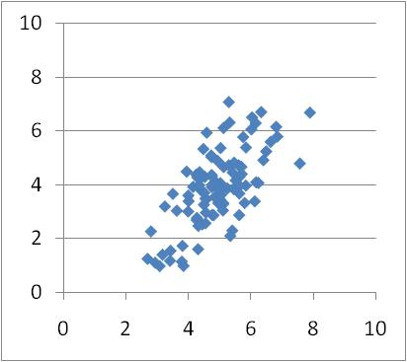
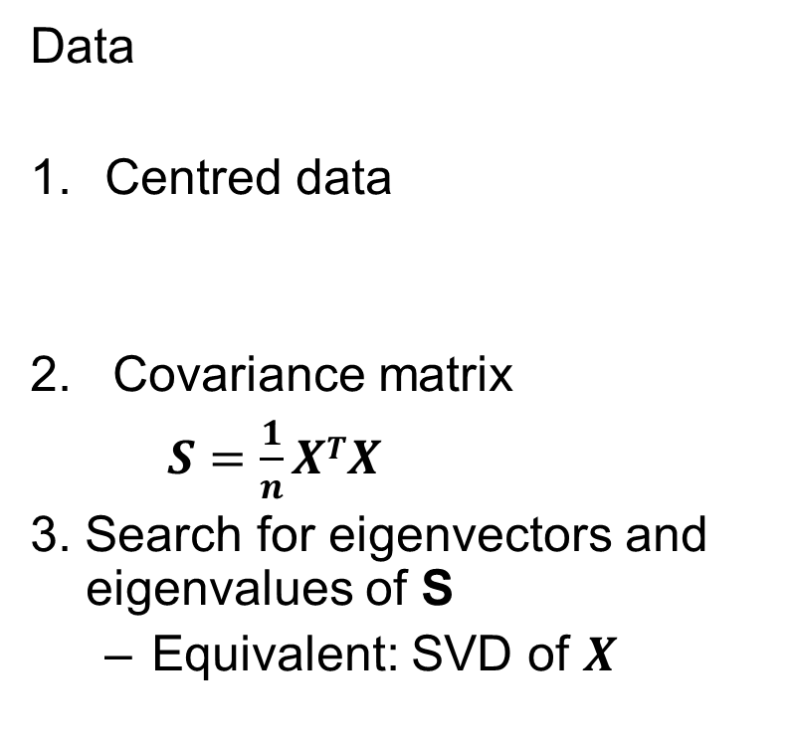
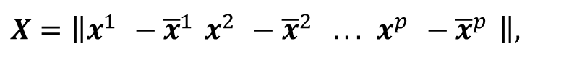
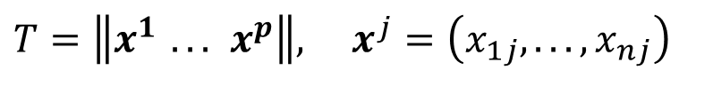
PCA: computations
Data
Centred data
2. Covariance matrix
$S=\frac{1}{n}XTX$
3. Search for eigenvectors and eigenvalues of S
Equivalent: SVD of $X$
$$T=\left\|x^{1} ... x^{p}\right\|, x^{j}=\left(x_{1j},...,x_{nj}\right)$$
$$X=\left\|x^{1} −{\overline{x}}^{1} x^{2} −{\overline{x}}^{2} ... x^{p} −{\overline{x}}^{p} \right\|,$$

Slide 10
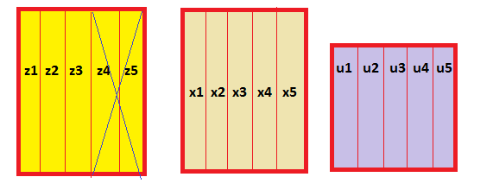
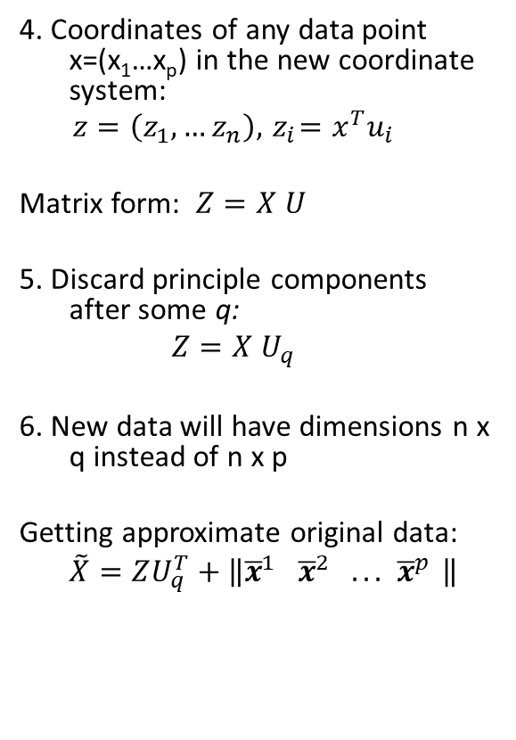
PCA: computations
4. Coordinates of any data point x=(x₁…x_{p}) in the new coordinate system:
$$z=\left(z_{1},…z_{n}\right),{ z}_{i}=x^{T}u_{i}$$
Matrix form: $Z=X U$
5. Discard principle components after some q:
$$Z=X U_{q}$$
6. New data will have dimensions n x q instead of n x p
Getting approximate original data:
$$\tilde{X}=ZU_{q}^{T}+\left\|{\overline{x}}^{1} {\overline{x}}^{2} ... {\overline{x}}^{p} \right\|$$
Store: n x q+ p x q
instead n x p
100*50 vs 100*4+50*4

Slide 11
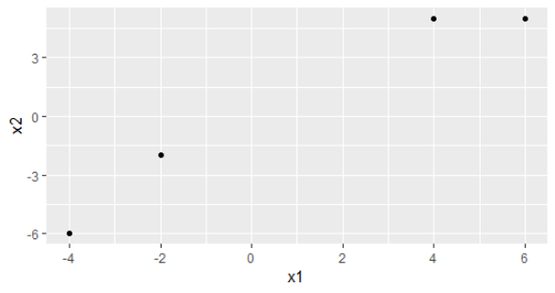
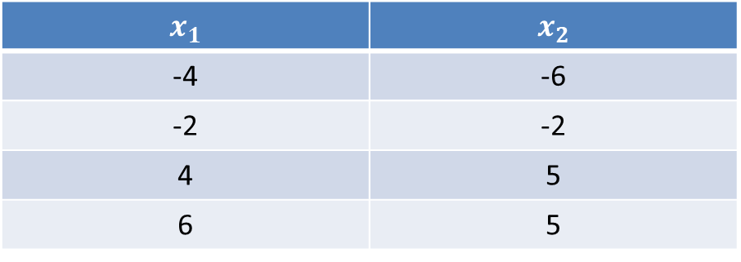
Example
$$x_{1}$$ | $$x_{2}$$
-4 | -6
-2 | -2
4 | 5
6 | 5

Slide 12
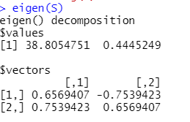
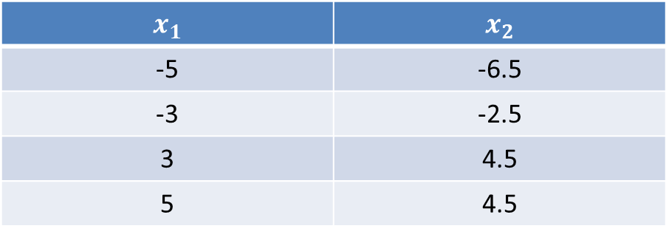
Example
Centered data
Eigenvectors of S
$$x_{1}$$ | $$x_{2}$$
-5 | -6.5
-3 | -2.5
3 | 4.5
5 | 4.5

Slide 13
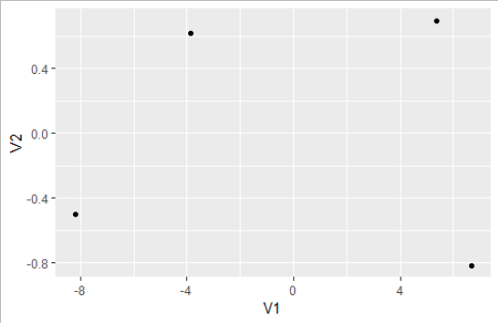
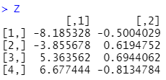

Example
Expressing new coordinates
$PC1:z_{1}=0.66x_{1}+0.75x_{2}$
$PC2:z_{2}=−0.75x_{1}+0.66x_{2}$
Which component has largest contribution to 1st PC?
Scores

Slide 14
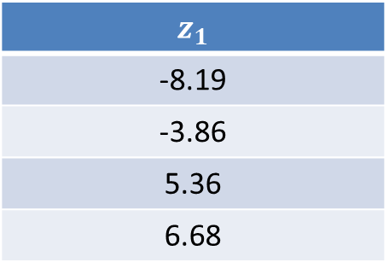
Example
Discarding PC2
New data
How much do we store now?
4*1+2*2=8
Have we reduced the storage?
$$z_{1}$$
-8.19
-3.86
5.36
6.68

Slide 15
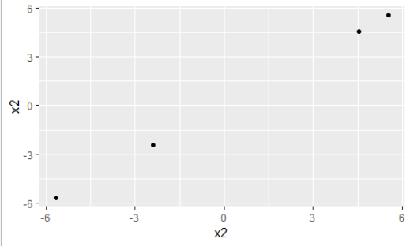


Example
Approximate original data
${\overline{x}}^{1}=1, { \overline{x}}^{2}=0.5$

Slide 16
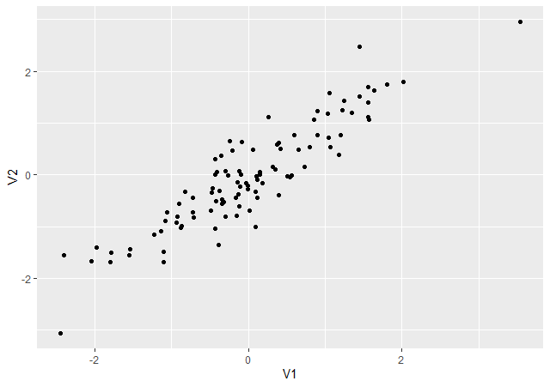
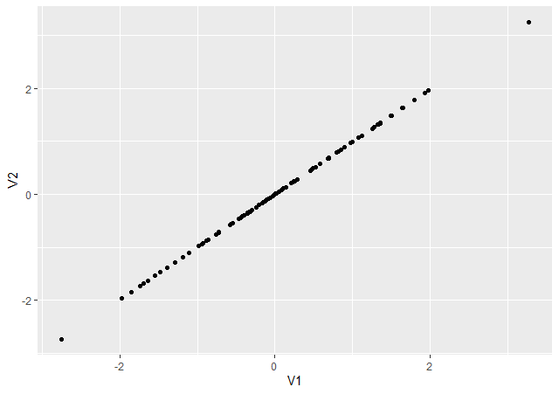
Example: more data
Data became approximate (but less data to store)
Original data
After compression

Slide 17
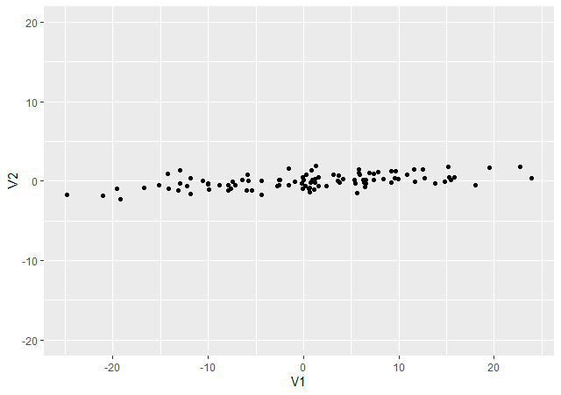
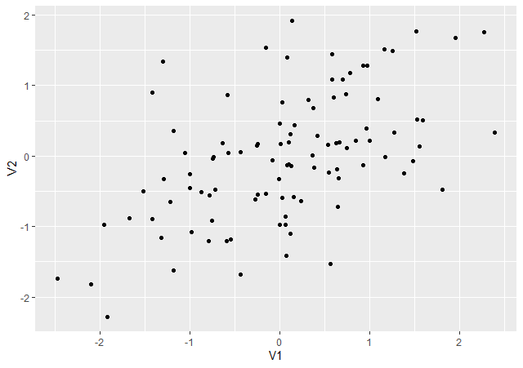
PCA and scaling
Do we need to scale features?
Without scaling
After scaling

Slide 18
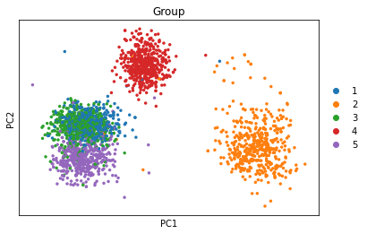
PCA
Reducing into 2 dim can enable studying structures
Example: gene expression data (20000 genes, 2500 cells)

Slide 19
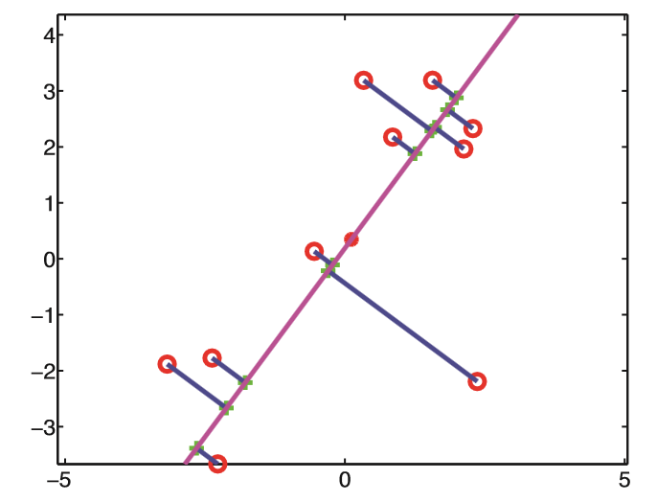

PCA: equivalent formulation
Aim: minimize the distance between the original and projected data
$$\min_{U_{M}}{\sum_{i=1}^{N}{{\left\|x_{n}−{\tilde{x}}_{n}\right\|}^{2}}}$$
Source: Murphy

Slide 20
















PCA: computations
PCA makes a linear compression of features
$${ x}_{1}$$
$${ \tilde{x}}_{1}$$
$${ x}_{2}$$
$${ z}_{1}$$
$${ \tilde{x}}_{2}$$
$${ x}_{3}$$
$$z=x^{T}⋅U_{q}$$
$${ z}_{2}$$
$$\tilde{x}=z^{T}⋅U_{q}^{T}$$
$${ \tilde{x}}_{3}$$
$${ x}_{4}$$
$${ \tilde{x}}_{4}$$
$$R^{p}$$
$$R^{q}, q<p$$
$$R^{p}$$
$$\min_{U_{q}}{\sum_{i=1}^{n}{{\left\|x_{n}−{\tilde{x}}_{n}\right\|}^{2}}}$$

Slide 21
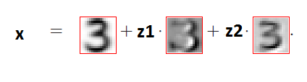
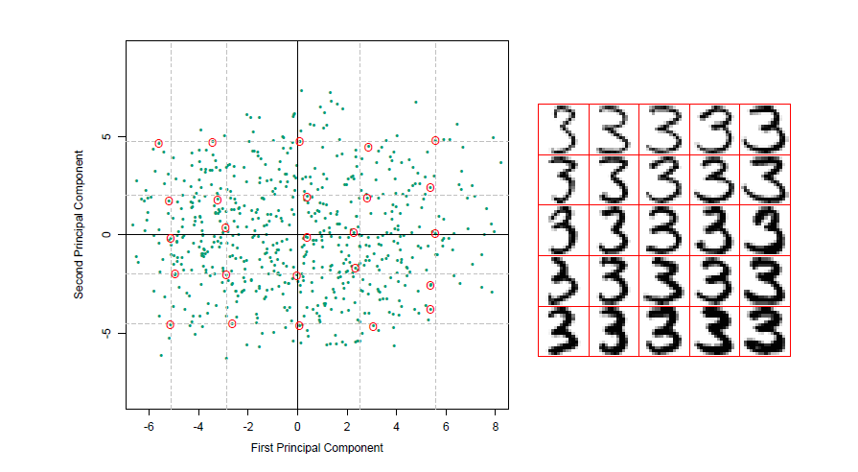
Principal Component Analysis
Digits: two eigenvectors extracted
Interptretation of eigenvectiors
Lower tail length
thickness

Slide 22
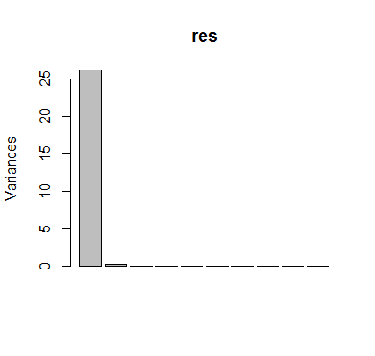


PCA in R
Prcomp(), biplot(), screeplot()
mydata=read.csv2("tecator.csv")
data1=mydata
data1$Fat=c()
res=prcomp(data1)
lambda=res$sdev^2
#eigenvalues
lambda
#proportion of variation
sprintf("%2.3f",lambda/sum(lambda)*100)
screeplot(res)
Only 1 component captures the 99% of variation!

Slide 23
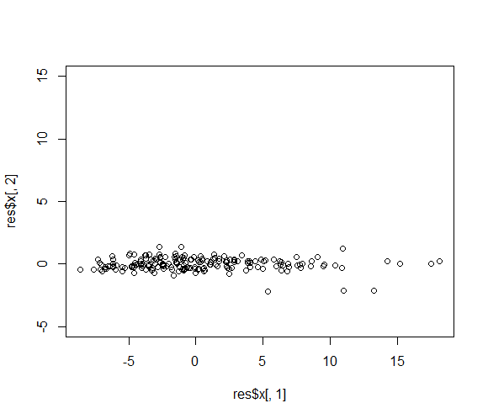
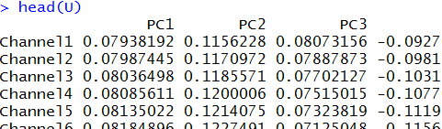
PCA in R
Principal component loadings (U)
Data in (PC1, PC2) – scores (Z)
U=res$rotation
head(U)
plot(res$x[,1], res$x[,2], ylim=c(-5,15))
Do we need the second dimension?

Slide 24
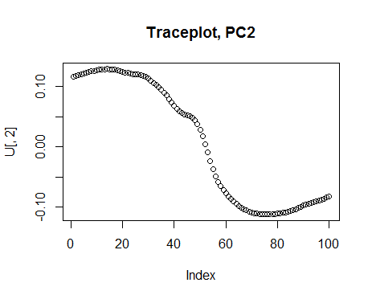
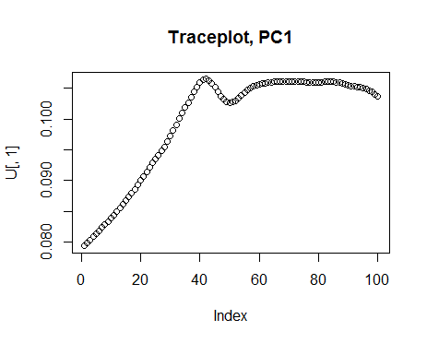
PCA in R
Trace plots
U= res$rotation
plot(U[,1], main="Traceplot, PC1")
plot(U[,2],main="Traceplot, PC2")
Which components contribute to PC1-2?

Slide 25

















Autoencoders (nonlinear PCA)
Why linear transformations? Take nonlinear instead!
$f()$ and $g()$ are typically Neural Networks
$${ x}_{1}$$
$${ \tilde{x}}_{1}$$
$${ x}_{2}$$
$${ z}_{1}$$
$${ \tilde{x}}_{2}$$
$${ x}_{3}$$
$$z=f(x,U)$$
$${ z}_{2}$$
$$\tilde{x}=g(z,R)$$
$${ \tilde{x}}_{3}$$
$${ x}_{4}$$
$${ \tilde{x}}_{4}$$
$$R^{p}$$
$$R^{q}, q<p$$
$$R^{p}$$
$$\min_{U,R}{\sum_{i=1}^{n}{{\left\|x_{n}−{\tilde{x}}_{n}\right\|}^{2}}}$$
…or some other cost function

Slide 26
Other linear representation learning methods
Probabilistic PCA
Similar to PCA but has more opportunities
Can be used to handle missing values directly
Can be easily embedded in Bayesian ML models
Can be used to generate new data
Independent component analysis (ICA)
Sometimes shows better emprical results compared to PCA

Slide 27
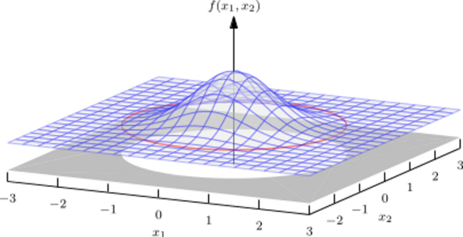
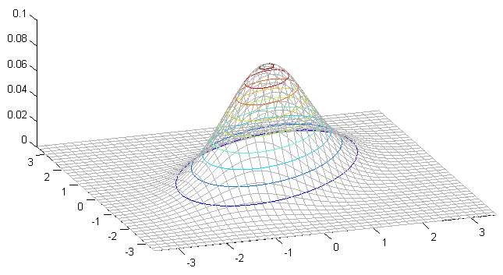
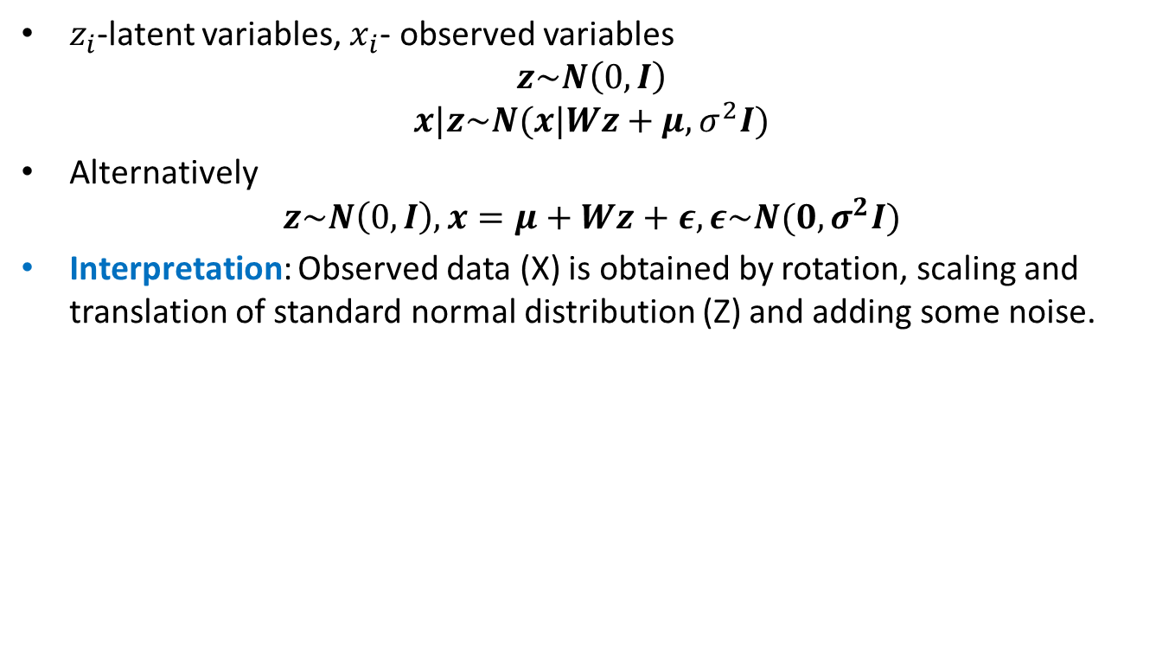
Probabilistic PCA
$z_{i}$-latent variables, $x_{i}$- observed variables
$$z\sim N\left(0,I\right)$$
$$x|z\sim N(x|Wz+μ, σ^{2}I)$$
Alternatively
$$z\sim N\left(0,I\right),x=μ+Wz+ε, ε\sim N(0, σ^{2}I)$$
Interpretation: Observed data (X) is obtained by rotation, scaling and translation of standard normal distribution (Z) and adding some noise.
X
Z
Z
X
Maximum likelihood

Slide 28
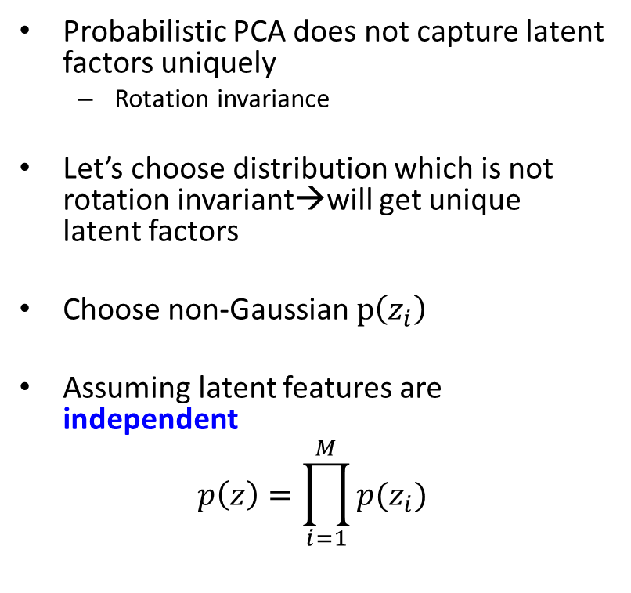

Independent component analysis (ICA)
Probabilistic PCA does not capture latent factors uniquely
Rotation invariance
Let’s choose distribution which is not rotation invariant→will get unique latent factors
Choose non-Gaussian $p\left(z_{i}\right)$
Assuming latent features are independent
$$p\left(z\right)=\prod_{i=1}^{M}{p(z_{i})}$$
$$p\left(z_{i}\right)=\frac{2}{π(e^{z_{i}}+e^{−z_{i}})}$$

Slide 29
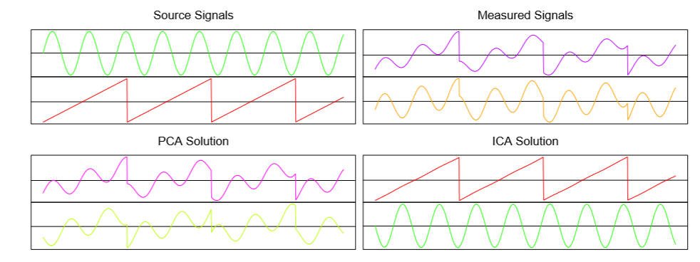
ICA
Example
Source: Elem of stat learn by Hastie

